Slide 1
Unconventional approaches to AI
Soumya Banerjee
sb2333@cam.ac.uk
Neel.Soumya@gmail.com

Slide 2
Insights from the past
Unconventional approaches in AI: complex systems perspectives, cognitive psychology, social sciences, computational models of creativity and other unconventional models
This is AI or classical AI before big data. The time is now ripe to revisit these wonderful ideas and think about how to incorporate them in modern AI/deep learning. Insights from the past can inform future approaches to AI, especially in the age of big data.
Looking at the heritage of computing and its interdisciplinary past can inspire new approaches for the future.
We need to learn lessons from the history of AI, what approaches worked and did not work in the past and how AI went through multiple winters.
These approaches can be used to develop techniques that can inspire explainable AI.

Slide 3
Approaches
Narratives and stories
How we make sense of our complex environment
Computational models of creativity and insight
Case based reasoning
Doctors, lawyers
Analogies
Dreams
Aid generalization and prevent overfitting
Commonsense reasoning

Slide 4
Computational models of creativity and insight
We are told of eureka moments (Archimedes, newton, …)
In reality, we always build on the work of others
There is a preparation stage
Incubation stage
Retrieval/indexing (kekule dreaming of a snake and then linking it to benzene rings)
A computational model of scientific insight, pat Langley, 1986
Notes:
Psychology of invention (Hadamard)
Kekule
Link to dreams
poincare

Slide 5

ANALOGIES
A computational model of scientific insight, 1986, Langley et al.

Slide 6
analogy
Abstraction and reasoning
Abc -> ABD
XYZ -> ?
ABC -> ABD
IIJJKK -> ?
Notes:
We are told of eureka moments (Archimedes, Newton, etc.). In reality we always build on the work of others.
There is a preparation stage, incubation stage and retrieval/indexing (e.g. Kekule dreaming of a snake and then linking it to benzene rings).

Slide 7

analogy
M. Mitchell and D.R. Hofstadter / The emergence of understanding in a computer model of concepts and analogy-making

Slide 8

Approaches
M. Mitchell and D.R. Hofstadter / The emergence of understanding in a computer model of concepts and analogy-making

Slide 9

Approaches
M. Mitchell and D.R. Hofstadter / The emergence of understanding in a computer model of concepts and analogy-making

Slide 10


M. Mitchell and D.R. Hofstadter / The emergence of understanding in a computer model of concepts and analogy-making
Notes:
Abc -> abd, xyz -> wyz

Slide 11

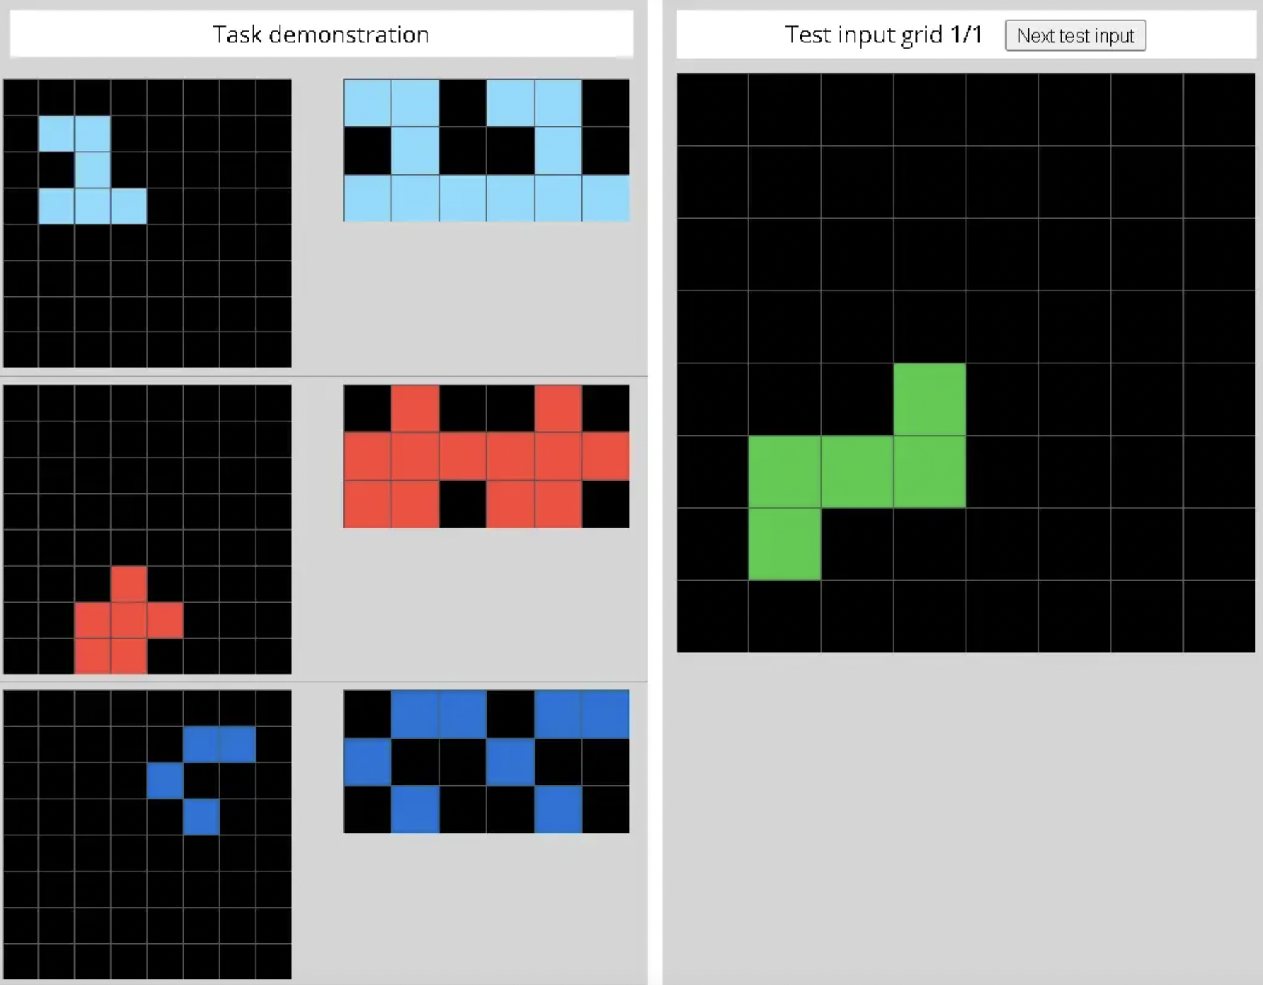
New data
Abstraction and reasoning corpus
On the measure of intelligence, francois chollet 2019
https://medium.com/jovianml/finishing-2nd-in-kaggles-abstraction-and-reasoning-challenge-24e59c07b50a

Slide 12


Analogies: Structure mapping engine
The Structure-Mapping Engine: Algorithm and Examples, falkenheiner & forbus

Slide 13

Qualitative process models
Qualitative process models
Notes:
Forbus, Qualitative process models

Slide 14
Approaches
Narratives and stories (Patrick Winston)
How we make sense of our complex environment

Slide 15
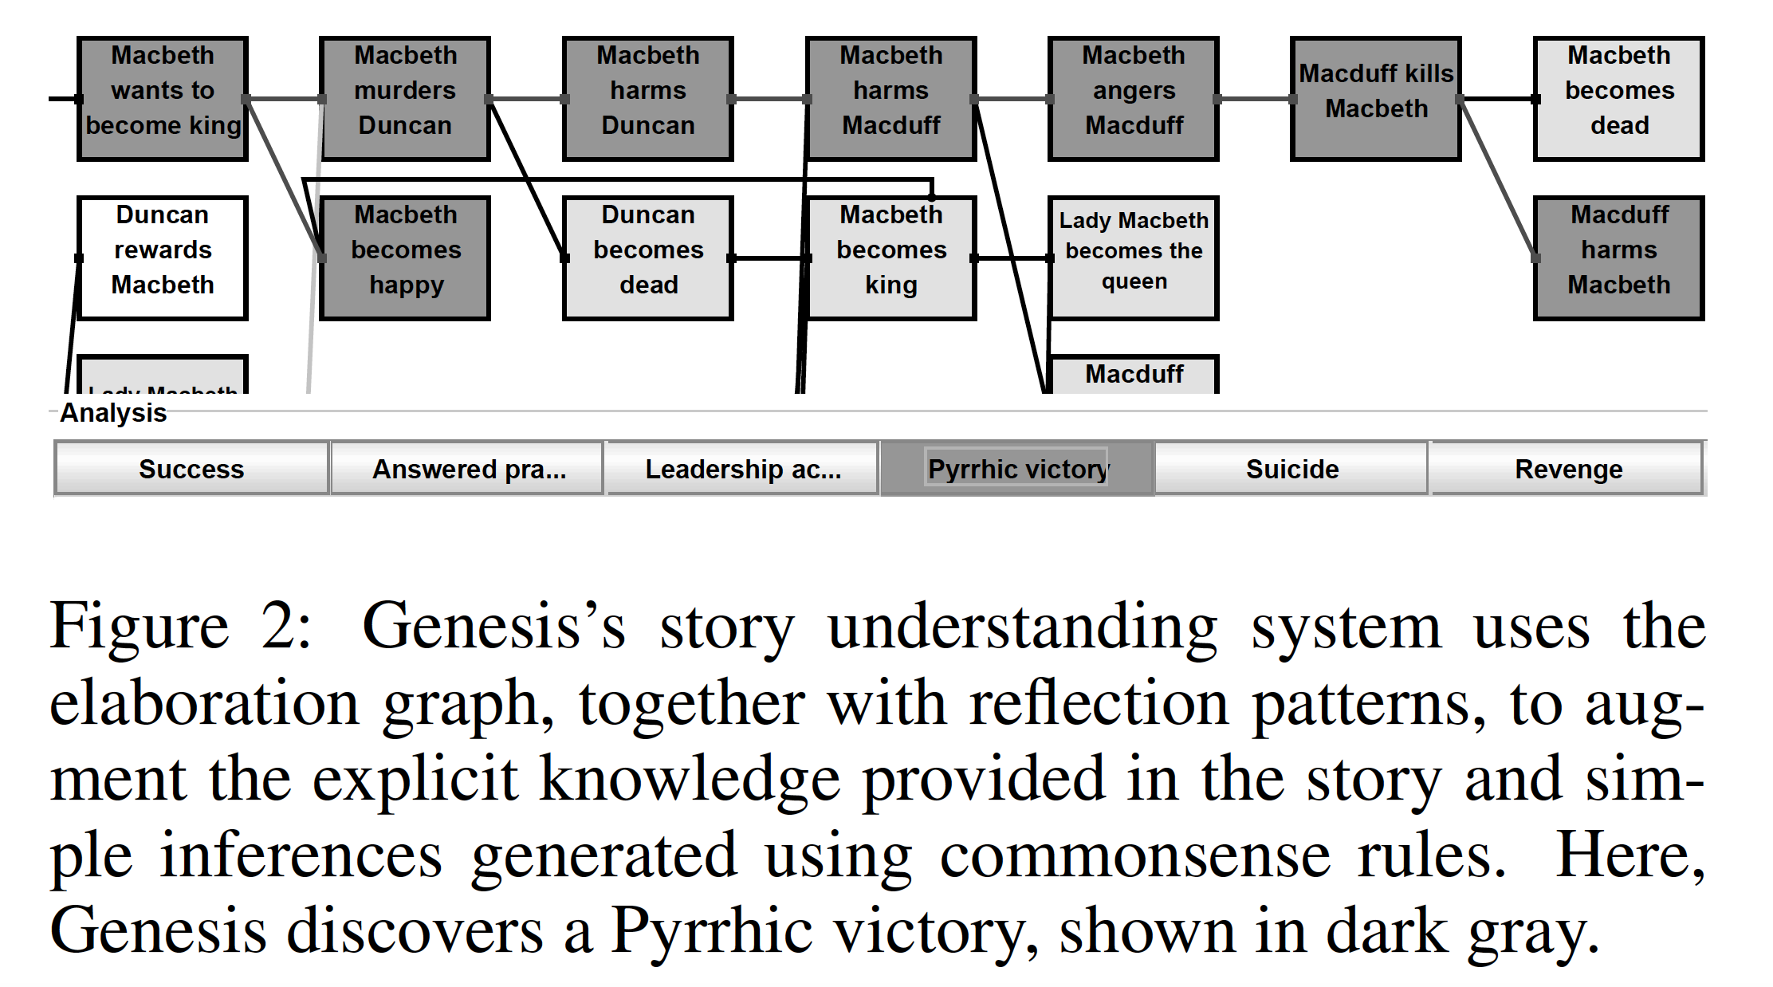
Story understanding
The Strong Story Hypothesis and the Directed Perception Hypothesis, Winston, 2011
Notes:
Macbeth
Pyrrhic victory
https://www.rsc.org.uk/shakespeare-learning-zone/macbeth/story/plot

Slide 16

STORIES AND ANALOGIES
Zen koan, ten bulls, Wikipedia

Slide 17
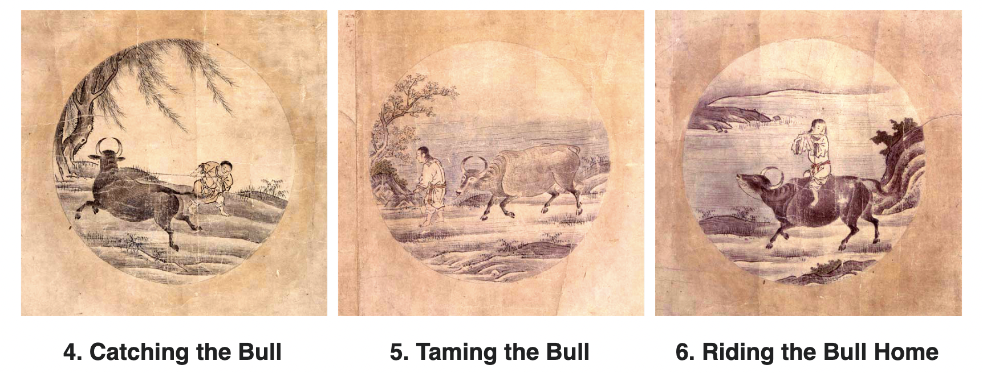
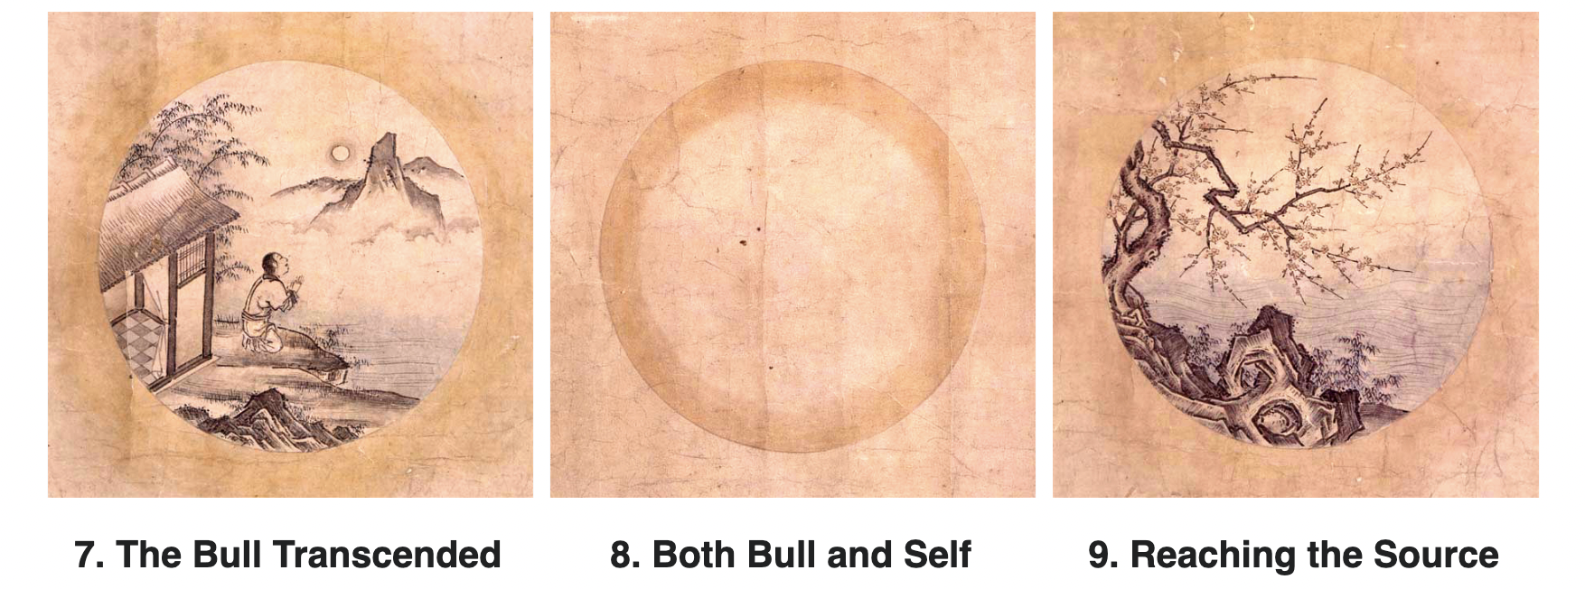
STORIES AND ANALOGIES
Zen koan, ten bulls, Wikipedia
Notes:
Kuòān Shīyuǎn

Slide 18
Large language models
Can large language models reason or understand?
https://arxiv.org/pdf/2210.13966.pdf
Are they capable of consciousness?
https://www.economist.com/by-invitation/2022/09/02/artificial-neural-networks-are-making-strides-towards-consciousness-according-to-blaise-aguera-y-arcas
World models in large language models
https://arxiv.org/pdf/2310.02207.pdf
Notes:
Kuòān Shīyuǎn

Slide 19
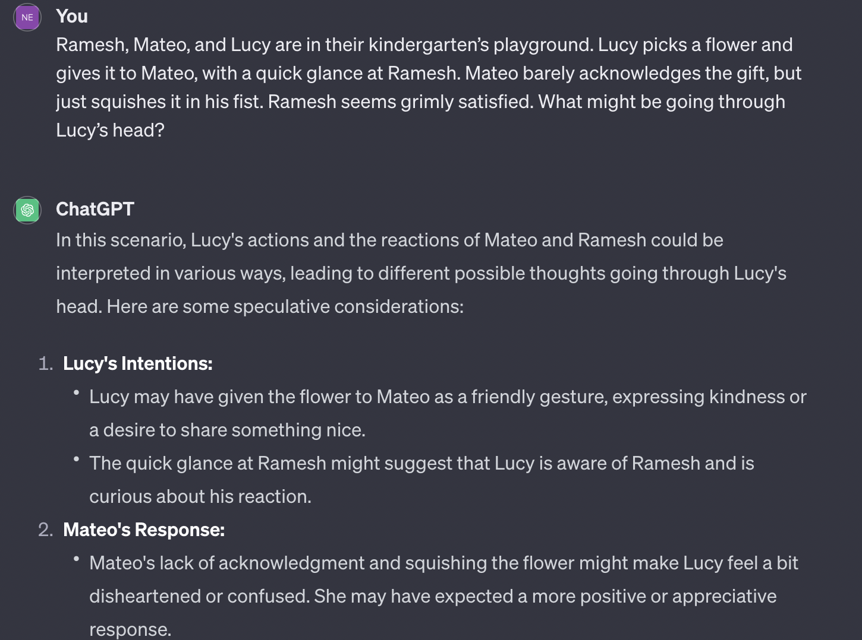
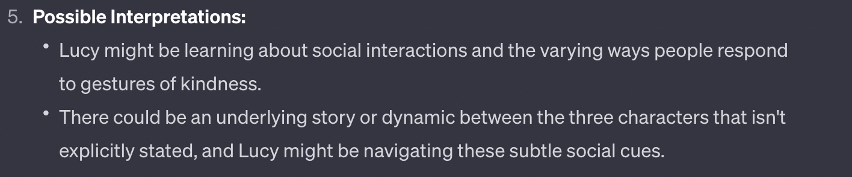
Notes:
Kuòān Shīyuǎn

Slide 20
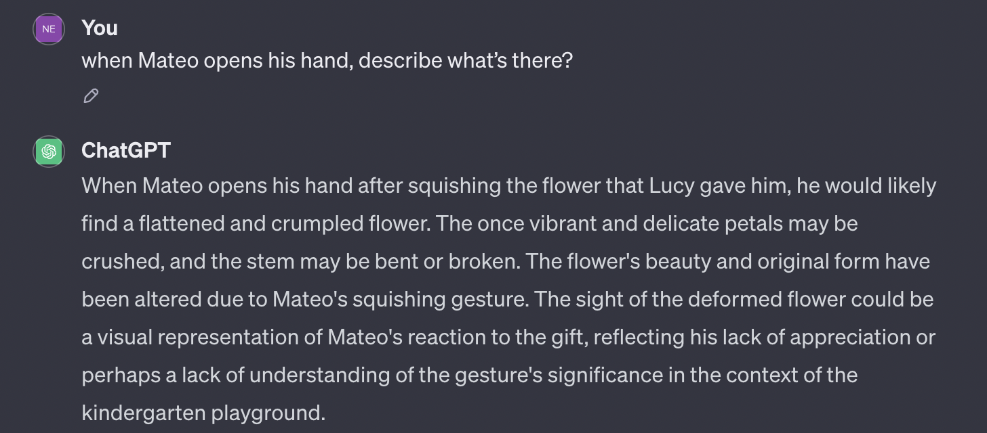
Can they understand the world or are they stochastic parrots?
Notes:
Kuòān Shīyuǎn

Slide 21
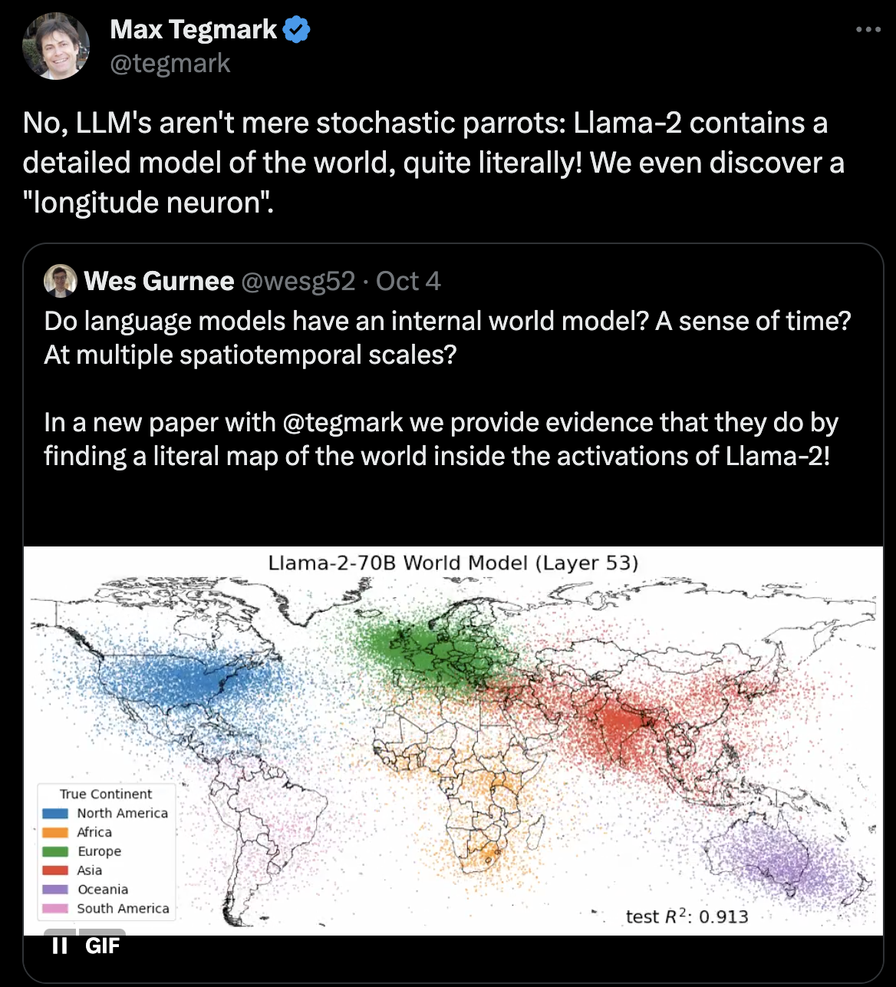
What is a worlD model?
Notes:
Kuòān Shīyuǎn

Slide 22
Large language models
What would you change in order to incorporate understanding in large language models?
What kind of world model/representation would it need?
Research proposal
Notes:
% xx without a world model on top of exercise is hard
% world model tegmark paper
% https://aiguide.substack.com/p/why-the-abstraction-and-reasoning/comments#comment-13194264
% Sorcus
% I think without a world model there is no real way for the AI to get the "on top of" example right. Because it's the understanding of the world that allows humans to nuance that.
% Same with other abstractions. There is so much sensory input that our evolution needed us to abstract information in a way we can then use and learn. AI as it stands right now making progress here seems limited.

Slide 23
Collective intelligence
Other ideas
Other paths to intelligence (in other species)
Collective intelligence

Slide 24

Collective intelligence
Task allocation and division of labour
Complex nest architecture
No central designer
No individual has design for complete structure
stigmergy
Morphogenesis of termite mounds, pnas, 2019
Notes:
No entral designer and no one has a grand design for the entire structure

Slide 25

Collective intelligence
Cellular automata
if a living cell is too isolated (0 or 1 neighbor) then it dies the next evolution (death by under-population).
If it is reasonably surrounded (2 or 3 neighbors) then it remains alive, but what if it is surrounded by too many cells (4 or more neighbors) it dies to the next generation (death by over-population).
A cell can also become a live cell if a dead cell is surrounded by three living cells, then it becomes alive (birth by reproduction).
https://www.dcode.fr/game-of-life

Slide 26

Collective intelligence
cellular neural networks
Inspirations for novel deep learning algorithms
Collective intelligence for deep learning: A survey of recent developments
Soft Radial Basis Cellular Neural Network (SRB-CNN) based Robust Low-Cost Truck Detection using a Single Presence Detection Sensor, 2016

Slide 27

Collective intelligence
Grid world
Millions of agents
Evolution of co-operation, competition, altruism and other strategies
MAgent: A Many-Agent Reinforcement Learning Platform for Artificial Collective Intelligence, 2018

Slide 28
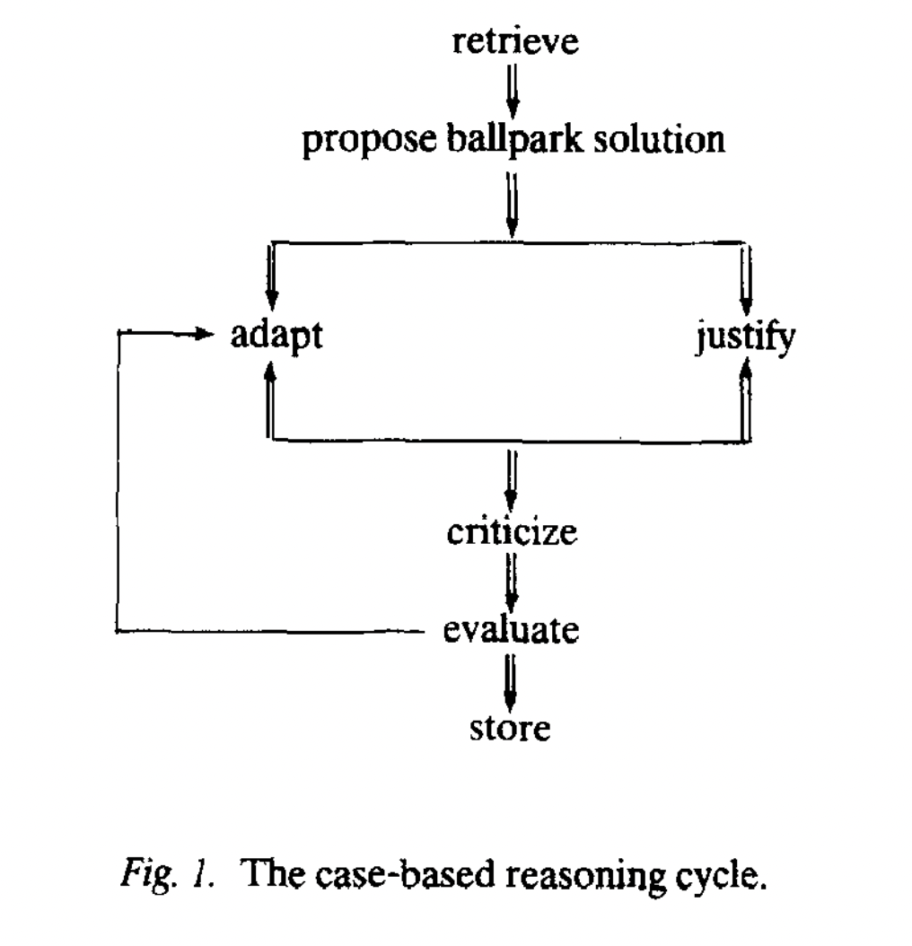
Case based reasoning
How humans reason
Doctors, lawyers, …
An introduction to case based reasoning, janet kolodner, 1992

Slide 29
Approaches
Dreams
Aid generalization and prevent overfitting
Commonsense reasoning (davis, Marcus)

Slide 30
explainability
Explainability (insights from social sciences)
Miller, 2019
How do you generate explainable models by working with domain experts
Rudin, 2019
Important for high stakes decisions in domains like healthcare, recidivism prediction
How can we take inspiration from all these approaches and develop new xAI techniques?
Notes:
\textit{ I argue that we can take inspiration from other disciplines and develop new xAI approaches.} Systems perspectives

Slide 31
resources
https://github.com/neelsoumya/special_topics_unconventional_AI

Slide 32
administrivia
PRESENTATIONS
Present and lead a discussion on one of these papers (or any other related paper: come speak with me).
The idea is that you raise some interesting questions.
This course is meant to teach you research skills (like thinking critically about a paper, literature review skills, writing).
15 min presentation, 15 min q&A

Slide 33
administrivia
WRITEUP/REPORT
on the paper you present, and the topic in general (unconventional AI).
do a literature review of other papers in the field.
reflect/write on how these techniques can be incorporated in modern AI/deep learning.
The intention is for you to
learn how to read papers
compare and contrast them to other papers
then think what this means for modern AI/deep learning.
Show me early drafts

Slide 34
administrivia
WRITEUP/REPORT
Short report (less than 4000 words). The idea is to write a coherent narrative.
Suggest how these ideas can be incorporated in modern AI/deep learning systems
Why do you think these ideas were not successful in the 1950s/1960s?
What kind of data would we need to ensure these techniques would work today?
What lessons can we learn from the history of AI, what approaches worked and did not work in the past?
What could be the disadvantages of these approaches?
Rational reconstruction (analytical literature review/survey) of a research area
Other thoughts on the writeup
A detailed research proposal with some ground work already accomplished

Slide 35
administrivia
HOW TO READ PAPERS
https://www.cs197.seas.harvard.edu/
https://docs.google.com/document/d/1bPhwNdCCKkm1_adD0rx1YV6r2JG98qYmTxutT5gdAdQ/edit#heading=h.yxlvj6bo3y2
Read widely and then focus on a few papers
Take multiple passes through papers

Slide 36
administrivia
HOW TO WRITE
WRITE REGULARLY
SCHEDULE TIME FOR WRITNG
https://sites.google.com/site/neelsoumya/research-resources/scientific-writing
https://www.youtube.com/watch?v=DeVjXINr5Wk
Book on writing (contact me to borrow a copy)
How to write a lot: a guide to productive academic writing (paul silvia)
Pick a paper now and start writing your thoughts

Slide 37
administrivia
PICK PAPERS AND ASSIGNED READING
Dates and names
We all read papers before the class
Class participation
Prepare a question beforehand

Slide 38

Zen koan, ten bulls, Wikipedia

